Slide 1



Notes:
I work for EPCC which is a part of UoE (was called Parallel Computer Centre). EPCC runs the Advanced Computing Facility just outside the city which hosts several supercomputers including the UK’s national supercomputer service. EPCC also hosts several TREs, the most famous/important being the Scottish NSH which is run on behalf of PHS for national-scale research studies.
The traditional type of TRE includes
VDI access to a remote desktop
Limited software
Cannot install other software without lengthy negotiations
Limited resources (CPU, RAM, disk space, GPUs)
No network access
CRAN mirror
EPCC also hosts traditional HPC environments such as the UK's national supercomputer
Massive resources (CPU, RAM, disk space, GPUs, CS-2)
Full internet access
Unix file sharing controls
Batch jobs, containers

Slide 2
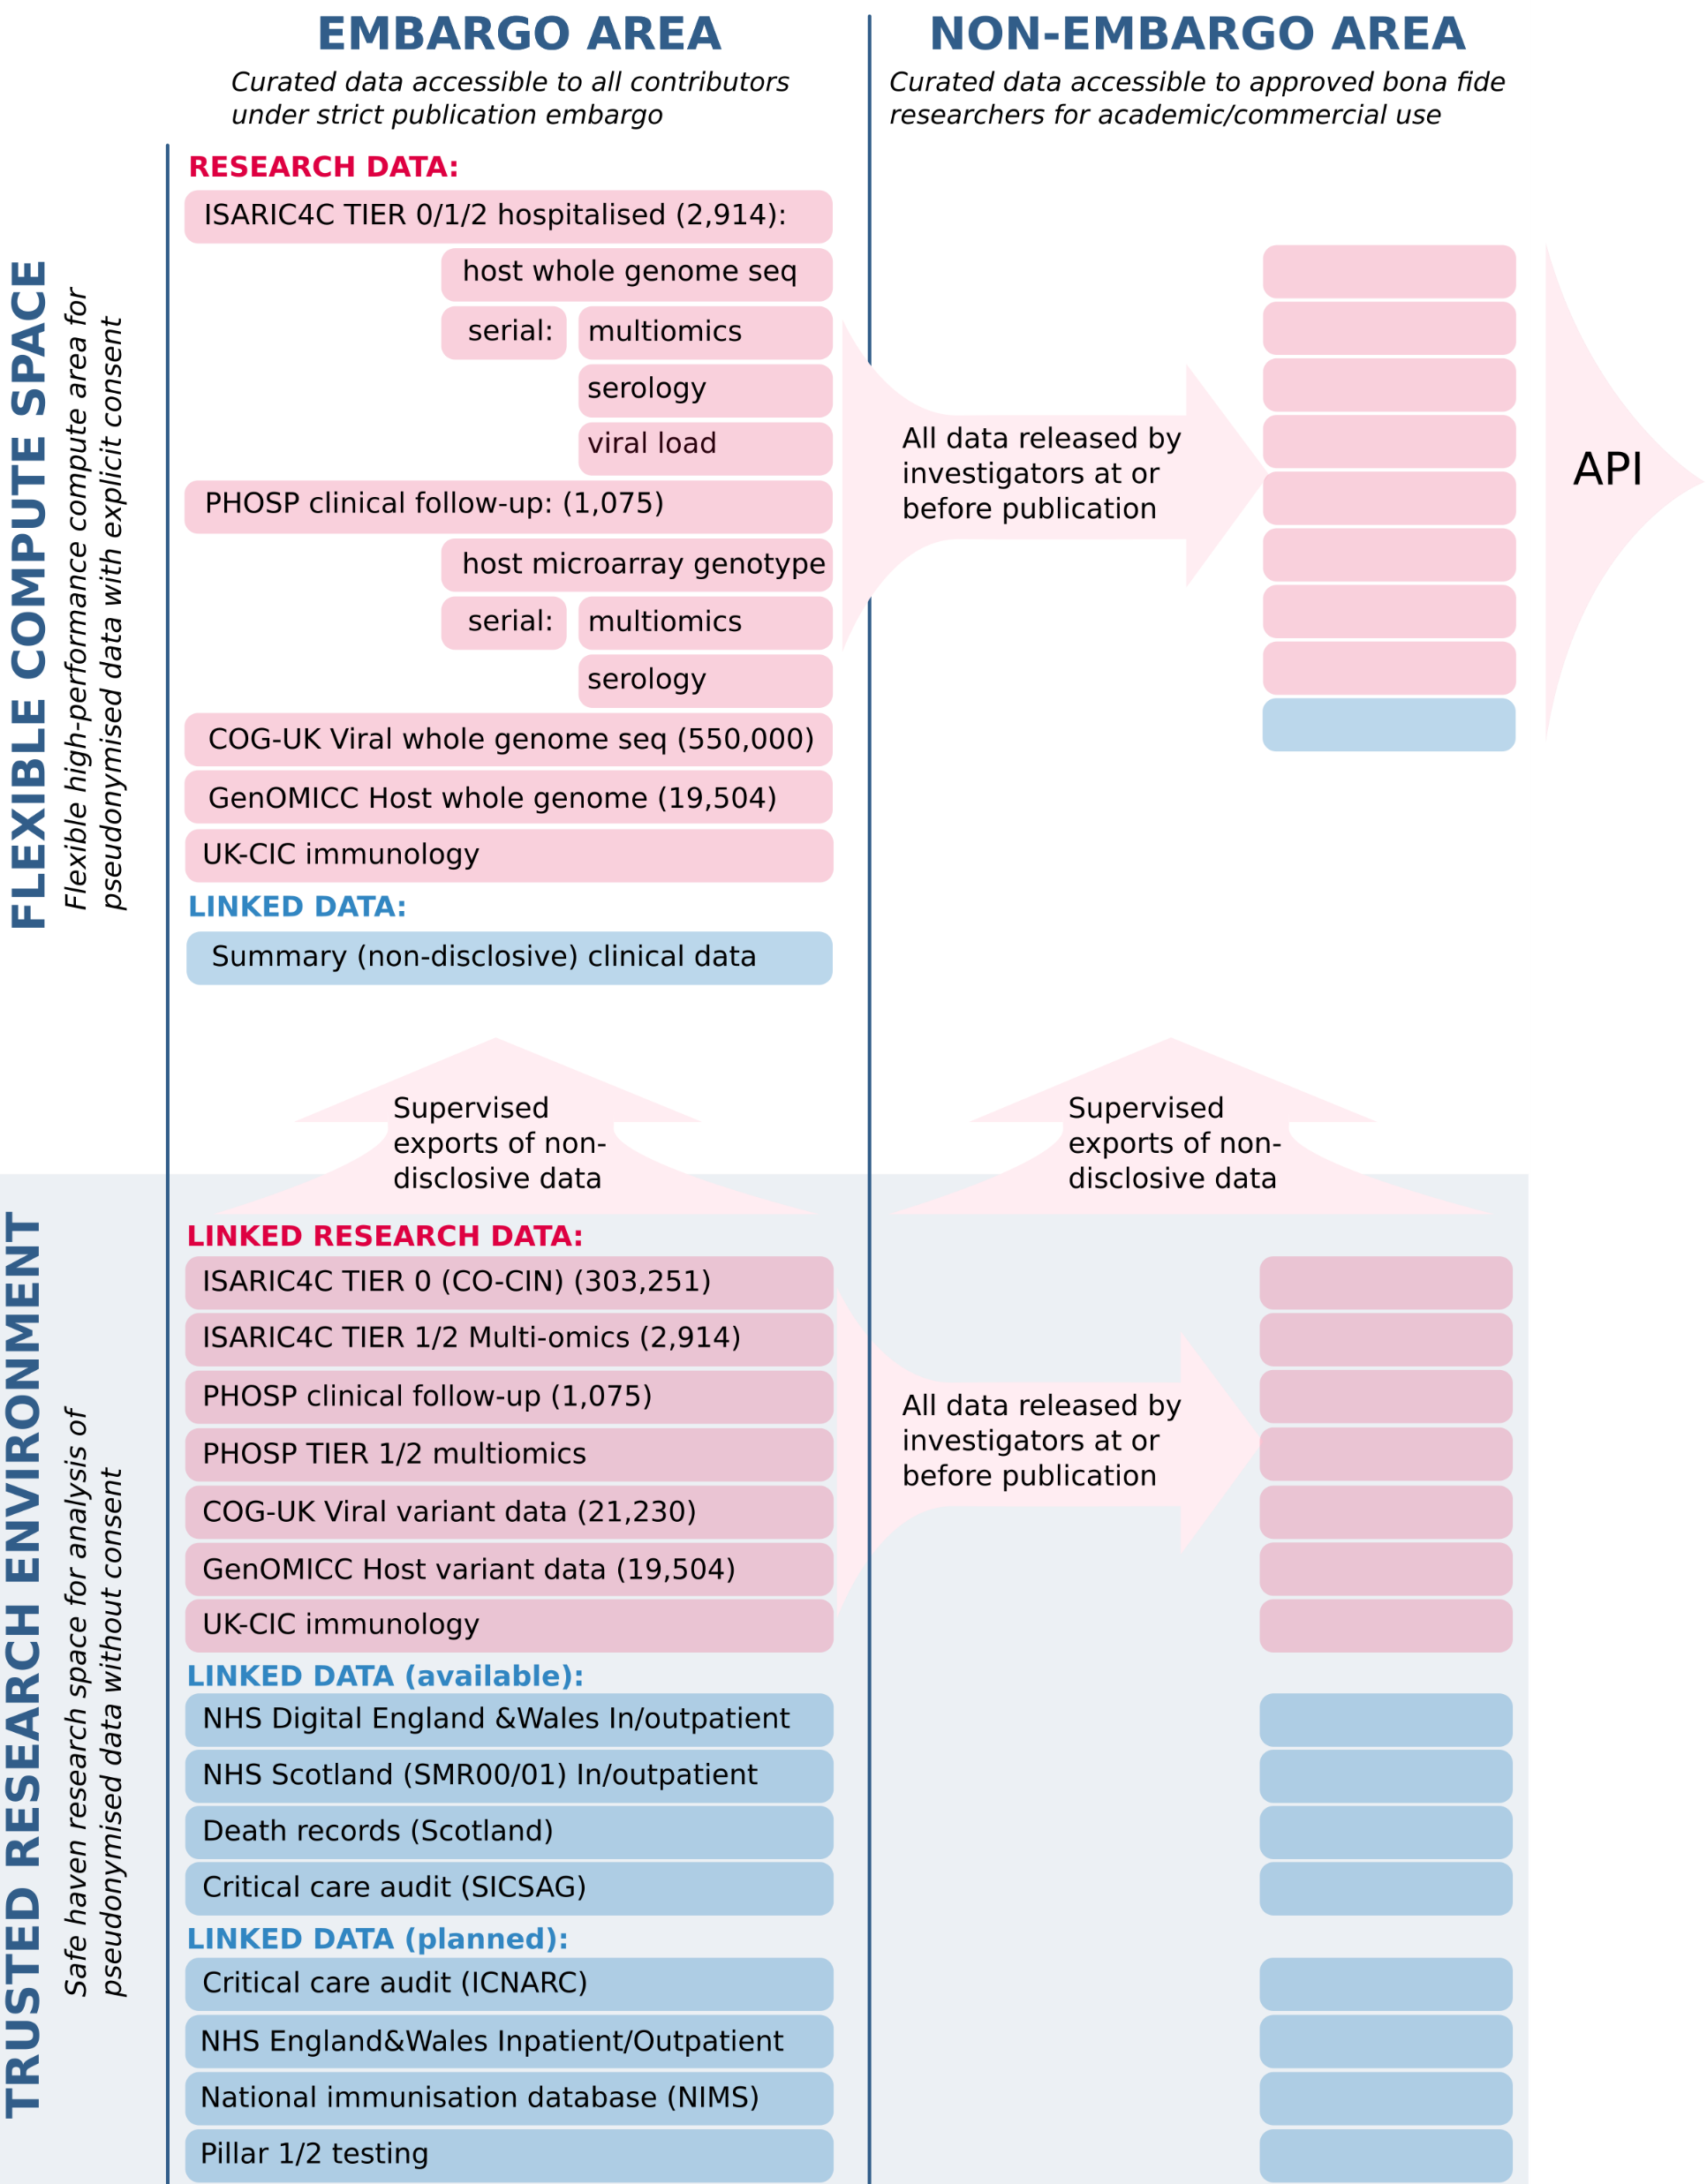
ODAP
The ODAP is designed to facilitate the rapid, collaborative, informative research to better understand and characterise new infections and clinical threats of public health interest. We curate, link and facilitate sharing of academic research with other UK data sources. The ODAP is built around the ISARIC Clinical Characterisation Protocol for Emerging Infections (CCP-UK), an internationally-harmonised UK-wide research study.
Notes:
When Covid hit there was a sudden explosion of research projects which required rapid access to datasets, so that caused a big demand to be more flexible in the provision of research resources, eg. more rapid access to TREs.
One such project was called ISARIC (International Severe Acute Respiratory Infection Consortium Clinical Characterisation Protocol). ODAP grew out of, or around, the ISARIC project. ODAP was designed to fulfil this demand with the shown datasets.

Slide 3
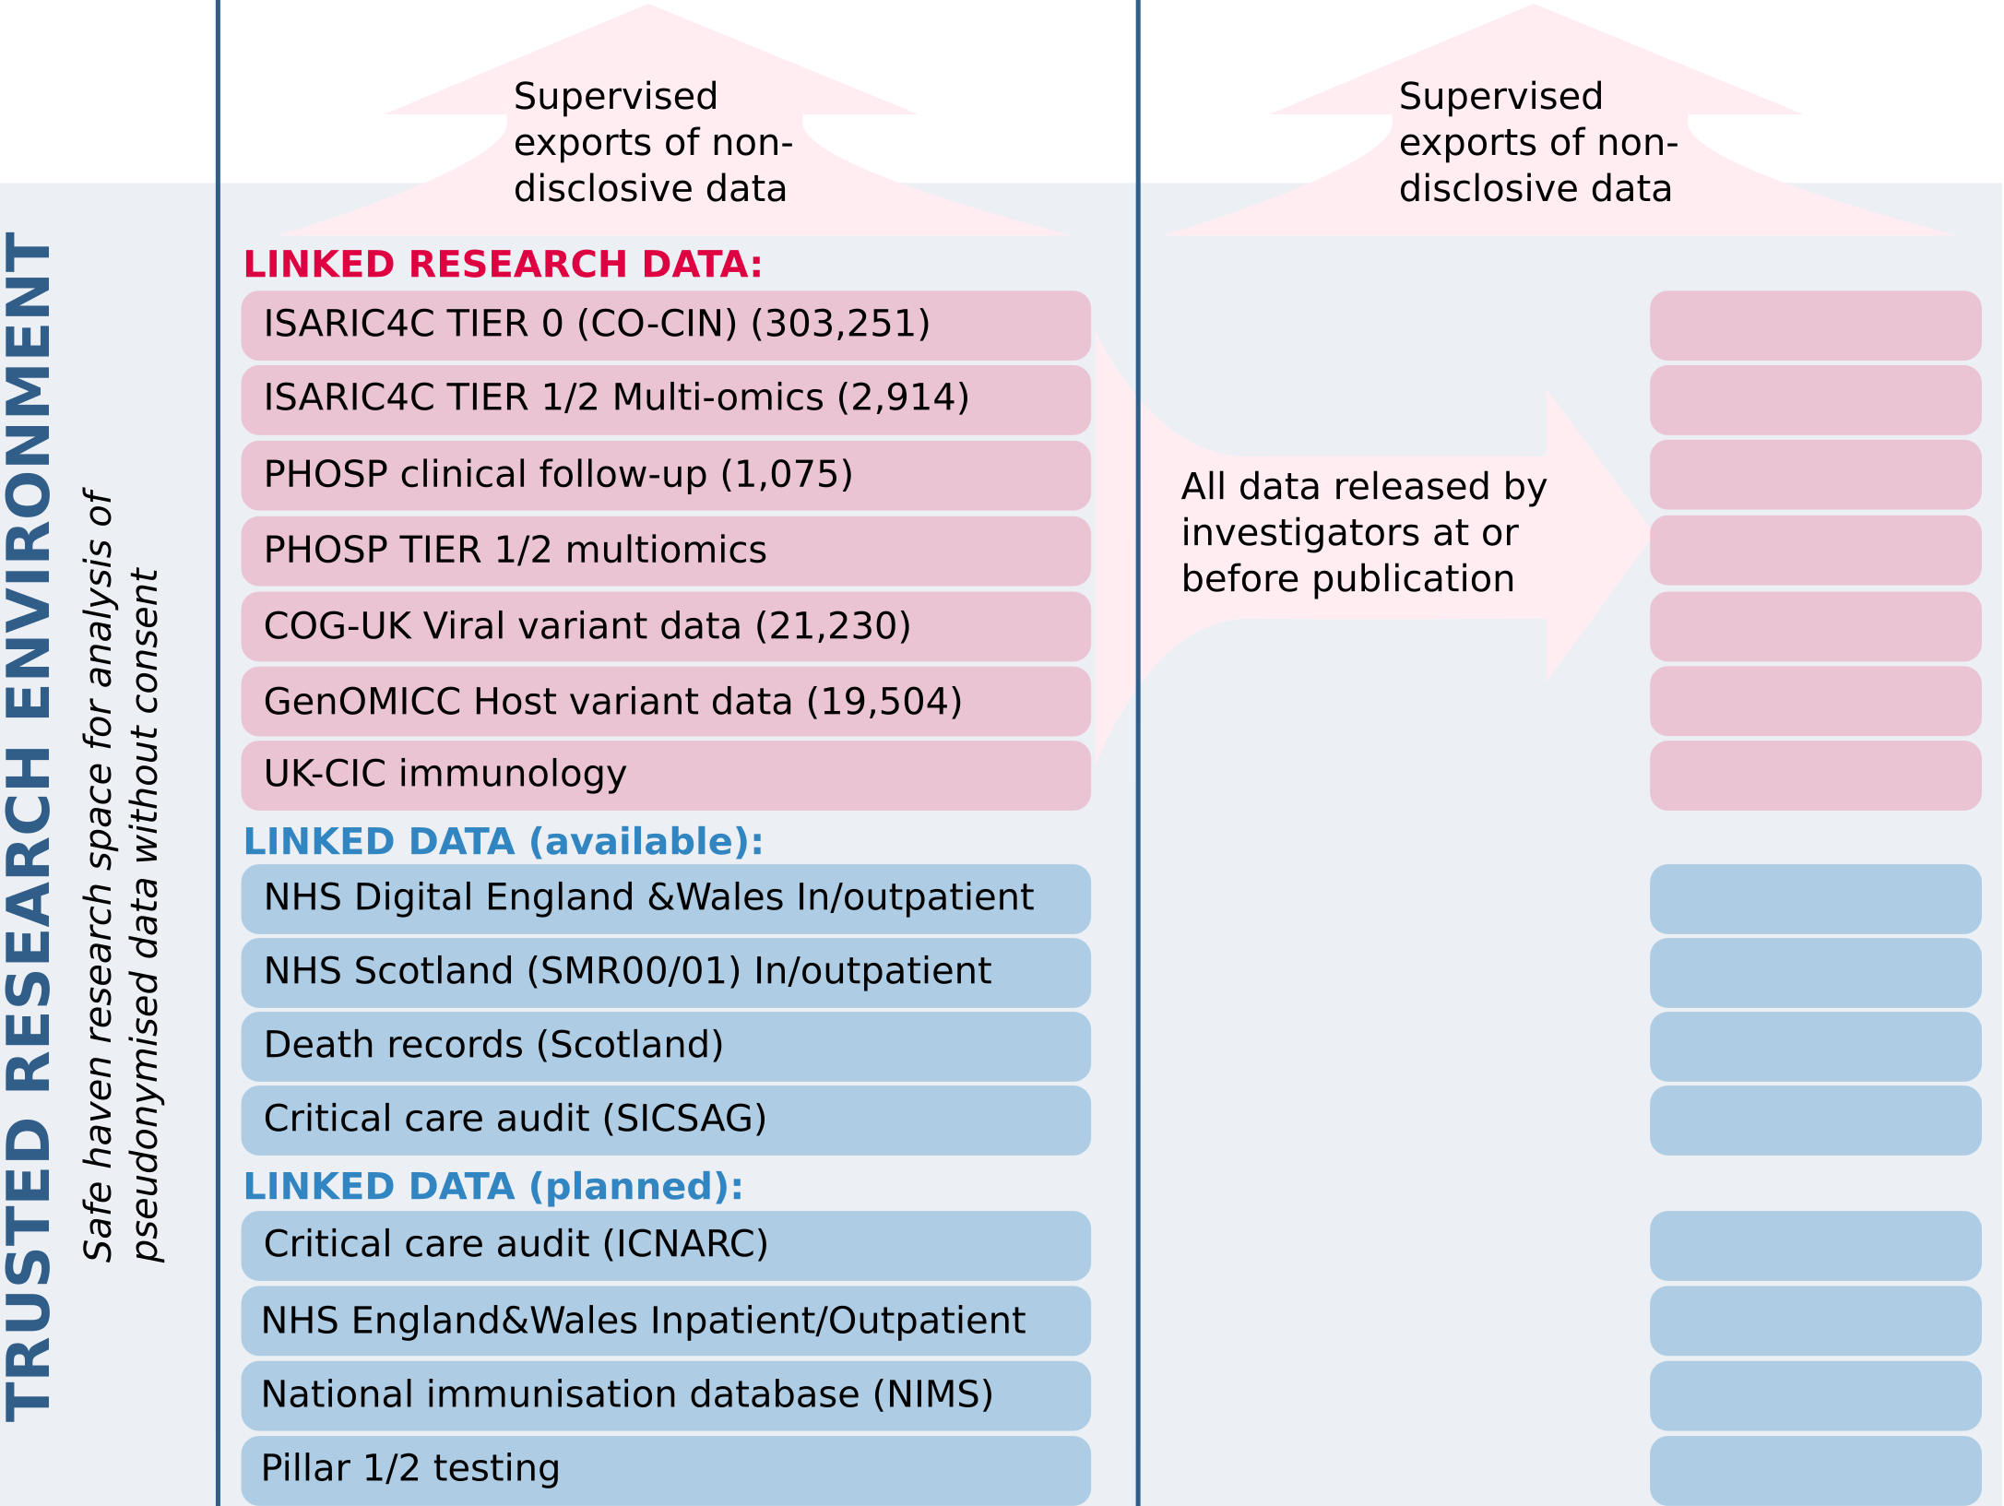
Traditional TRE Environment
Hosted in the National Safe Haven.
Research users get VDI access to a small desktop VM with limited resources.
Notes:
EPCC built a covid response system to help PHS which sits alongside the other resources in the NSH, which was fine, it could host unconsented patient data and perform linkages with other national datasets.
The limited resources created some problems
* This hampered their data cleaning - very wide tables with 1 million patients took too long
* Had to provide users with database access to host GB-sized datasets

Slide 4
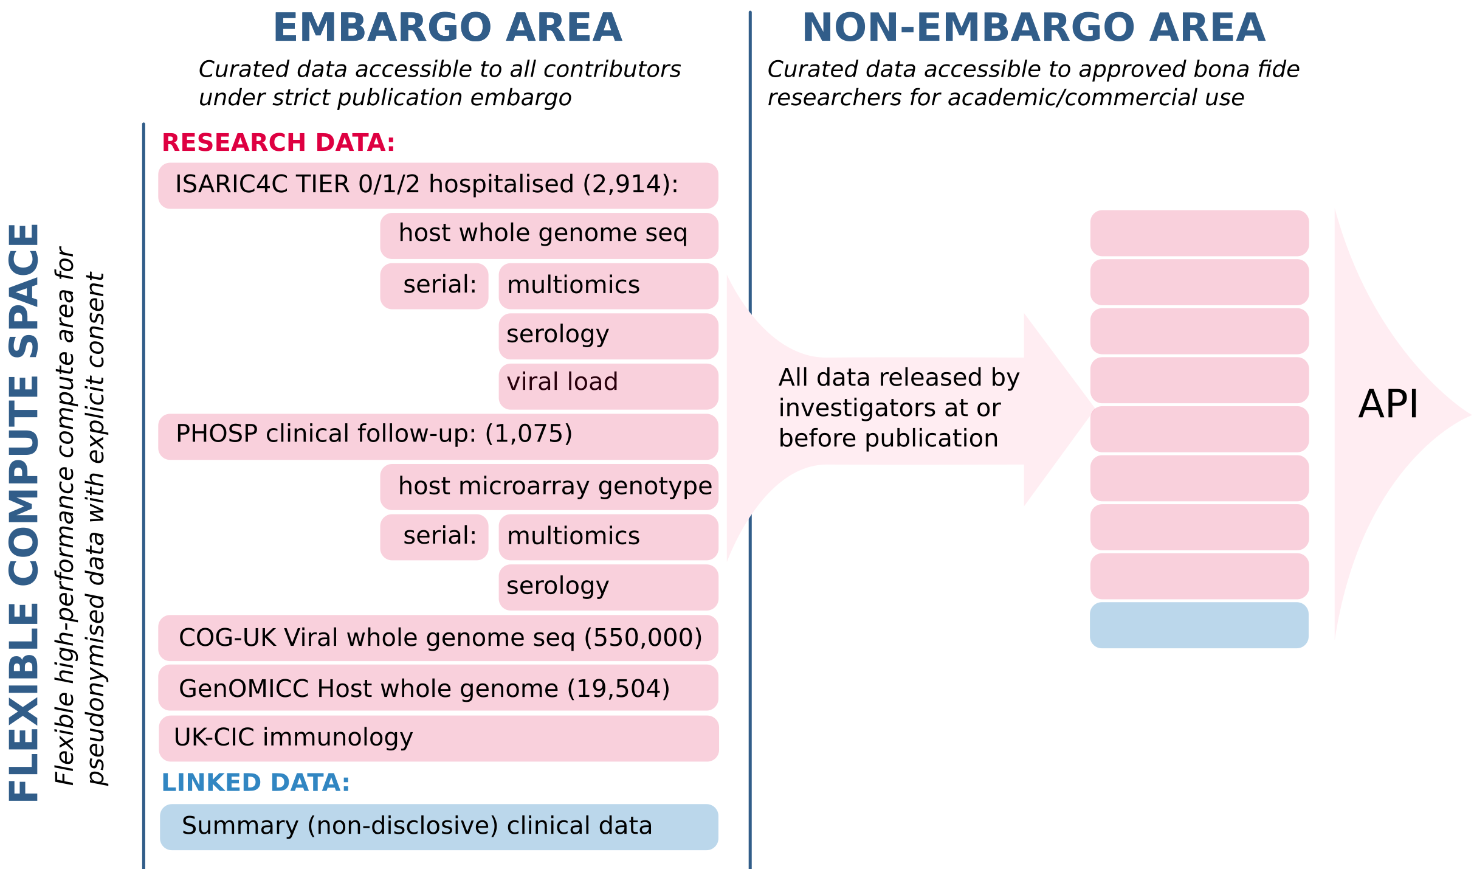
ODAP “Flexible Compute Space
Notes:
A large amount of the research needed two things: a more flexible resource and more compute power.
You can see the genomic data in there, which is an example of a dataset that wouldn’t sit well inside the traditional NSH infrastructure.

Slide 5
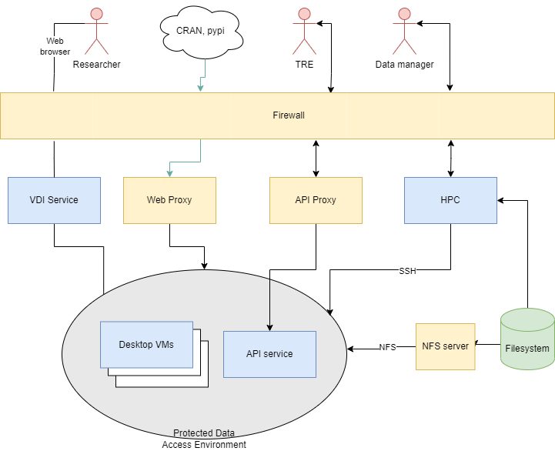
ODAP “Flexible Compute Space”
Notes:
A pseudo-TRE was developed on one of the HPC systems which could be used for holding consented pseudonymised data such as viral genomic sequences.
This was built as a Protected Data Access environment
1. the HPC resource (576 CPU, 18 TB RAM, 5 PB Disk)
2. set of VMs providing the desktop interface, with a VDI in front
3. proxy for access to PyPi and CRAN (and OS upgrades)
4. no internet access in HPC for project members
5. system for remote interpreters so RStudio and PyCharm can run on the desktop but execute their jobs on the HPC

Slide 6
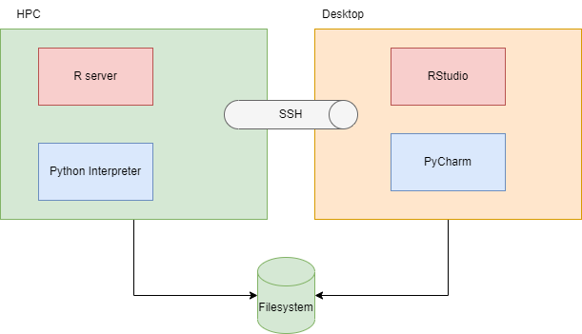
Remote R and Python interpreters
Notes:
One of the problems from separating the HPC resource from the desktop is how to run a GUI such a Rstudio and PyCharm in the desktop but make sure that all computation is performed on the HPC.
We implemented this using a SSH tunnel, but it does bring added complexity for users and the possibility of making mistakes.

Slide 7
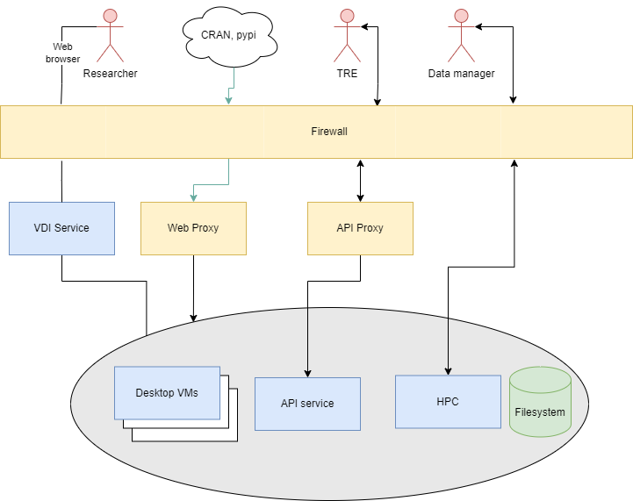
ODAP v2
Notes:
There's obviously some limitations in this system, and there’s a requirement that ODAP become a fully-fledged TRE capable of holding unconsented patient data,
so the future design involves moving the whole HPC system inside the Safe Haven Services environment
* which is very expensive!
* but the diagram fails to show the complexity of running multiple save havens within that environment
Looking for ways to improve this such as namespaces or containers

